Slide 1

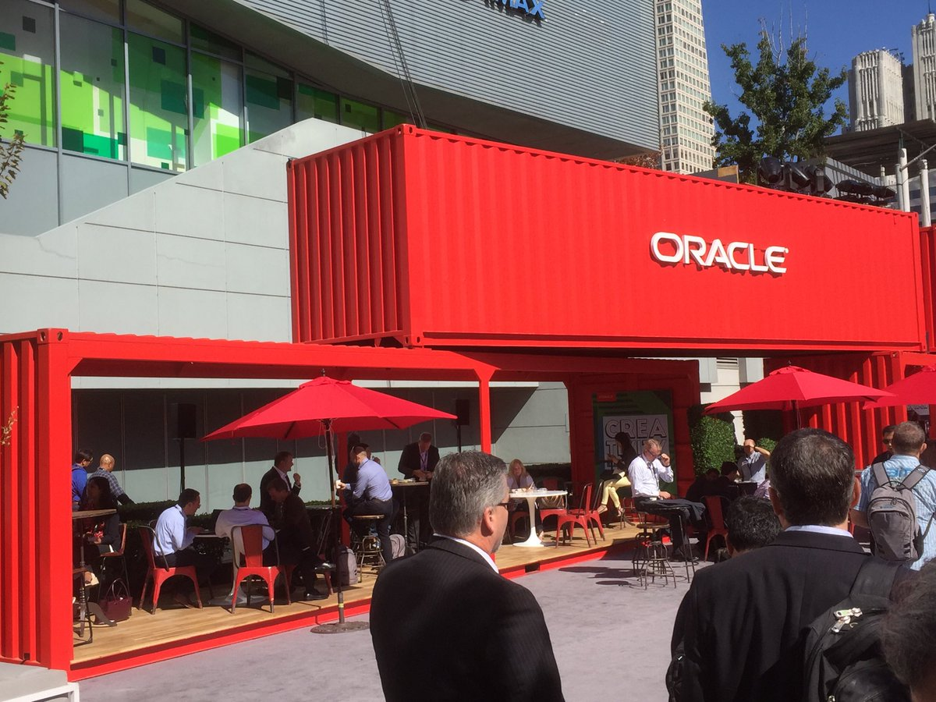

Introduction to the Oracle Cloud Microservices Platform open, manageable, polyglot and scalable
On what would be and still can be…
Lucas Jellema, CTO of AMIS
nlOUG TechExperience 2018, Amersfoort, The Netherlands

Slide 2
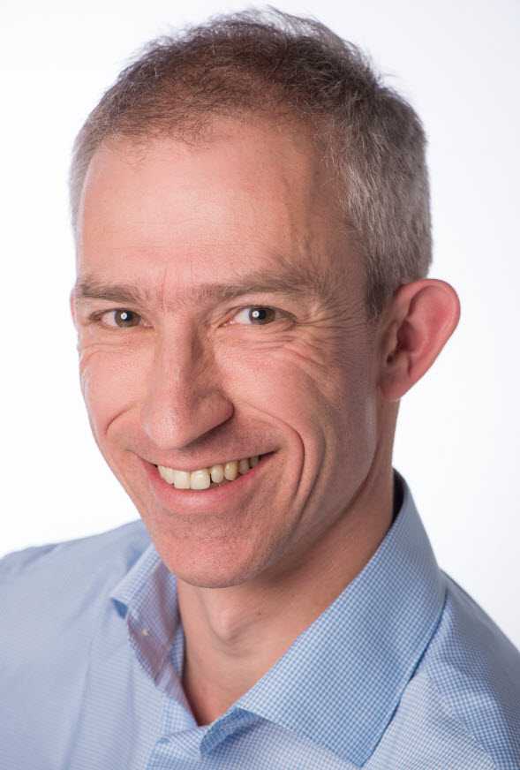
Lucas Jellema Architect / Developer 1994 started in IT at Oracle 2002 joined AMIS Currently CTO & Solution Architect

Slide 3
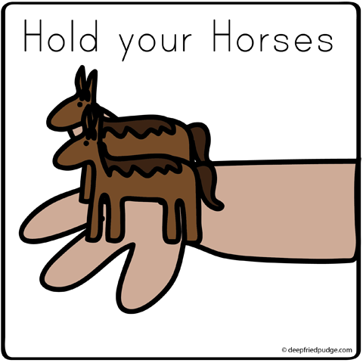
How do we implement microservices?
And how we make the containers horizontally scalable
How do we get from a Monolith to Microservices?

Slide 4
Why? What? How?
Notes:
Objectives
Requirements
Specifications

Slide 5
What is IT all about?
Production Runtime
Application

Slide 6
What is IT all about?
Production Runtime
Application
Platform

Slide 7
Objectives
Business Agility
In functionality: quick, cheap, effortless and risk free
IT Agility
In non-functionality: scale, resilience, infrastructure & location
Real working applications with rapid relevant evolution that run reliably

Slide 8
What is IT all about?
Production Runtime
Operations
Monitoring & Management
Application
Platform
Platform
Platform

Slide 9
Production Runtime is the Result of Preparation Runtime
Preparation Runtime
Production Runtime
Development
Operations
Monitoring & Management
Application
Application
Agile Design, Build, Test
Platform
Platform
CD

Slide 10
What?

Slide 11
One team has Agile responsibility through full lifecyle
Preparation Runtime
Production Runtime
Development
Operations
Monitoring & Management
Application
Application
Agile Design, Build, Test
Platform
Platform
CD

Slide 12
One team has Agile responsibility through full lifecyle
Preparation Runtime
Production Runtime
DevOps
Development
Operations
Monitoring & Management
Application
Application
Agile Design, Build, Test
Platform
Platform
CD
You build it, you run it, you fix it, you evolve

Slide 13
One team has Agile responsibility through full lifecyle
DevOps
Application
Application
Platform
Platform
You build it, you run it, you fix it, you evolve

Slide 14
DevOps team owns and runs one (or more) products
Application
Platform
Generic Infrastructure Platform for running DevOps Products
Floorspace, Power, Cooling, Storage, Compute
Monitoring, Management, Cache, Authentication, RDBMS, Event Hub

Slide 15
Multiple products from multiple teams run on a shared generic infrastructure
Application
Application
Application
Application
Application
Platform
Platform
Platform
Platform
Platform
Generic Infrastructure Platform for running DevOps Products
Floorspace, Power, Cooling, Storage, Compute
Monitoring, Management, Cache, Authentication, RDBMS, Event Hub

Slide 16
(Application plus platform)under DevOps ==
µ
µ
µ
µ
µ
Generic Infrastructure Platform for running DevOps Products
Microservice

Slide 17
What?
Realistic approach (technology, people, process) => Something that works!
No dependency on individuals
Able to scale in rate of change
Small, well: comprehensible, manageable
Stand alone /isolated/encapsulated (in terms of change, release/deploy, scale, location, implementation technology)
Provide clear and meaningful functionality in a way that it can be consumed
One microservice does not completely fall over when other microservices break (or are redeployed)
Able to scale elastically & horizontally and relocate easily

Slide 18
How?

Slide 19
How microservices
One team owns the microservice and can do functional and technical evolution and deployment continuously and independently
The business ownership is clearly defined
Application
Platform

Slide 20
The Microservice
HTTP REST/JSON
API

Slide 21

How microservices: design & implement
Business & Team ownership of application and associated platform
Automated CD – including regression test
Open (standards, protocols) on the outside, whatever you like inside
Deployable on enterprise standardized microservices platform
API & Event
Standard protocols for interaction
Horizontally scalable: multiple parallel instances
Stateless instances – horizontally scalable up & down, can handle fail over & restart
Private Bounded (Data) Context
Including derived data from other domains

Slide 22

Notes:
Viktor Korchnoi – Stateless Chessplayer

Slide 23
Microservices State
Generic Platform for running microservices
LDAP
Big Data
Block Storage
Cache
RDBMS
NoSQL
Document Store
Event Hub
Notes:
All data stores are distributed
Or at least distributedly available
They can be local or on cloud (latency is important)
Data in generic data store is still owned by only one microservice – no one can touch it
Only in DWH and BigData do we deliberately take copies of data and disown them

Slide 24
Bounded context in microservices
A micoservice needs to be able to run independently
It needs to contain & own all data required to run
It cannot depend on other microservices
UI
API
Customer
API
Order
CustomerModified event

Slide 25

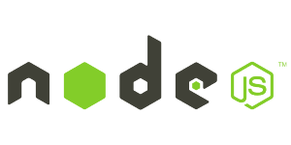






Demo – Maintaining Derived Data in Bounded Context
Customer Microservice
Order Microservice
Customer Modified Event
Application Container
Application Container
Event Hub
Customers
Topic
DBaaS

Slide 26
Microservices based Webshop
Web Shop Portal
µ Customers
µ Orders
µ Products
µ Loyalty
µ Finance
µ Logistics
µ Customers
µ Orders
µ Products
µ Loyalty
µ Finance
Notes:
dazzle the audience with a quick dump of all technologies (and cloud services) used for putting the webshop together - for the UI, the API implementation, the datastores and the event bus.

Slide 27




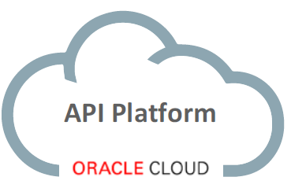
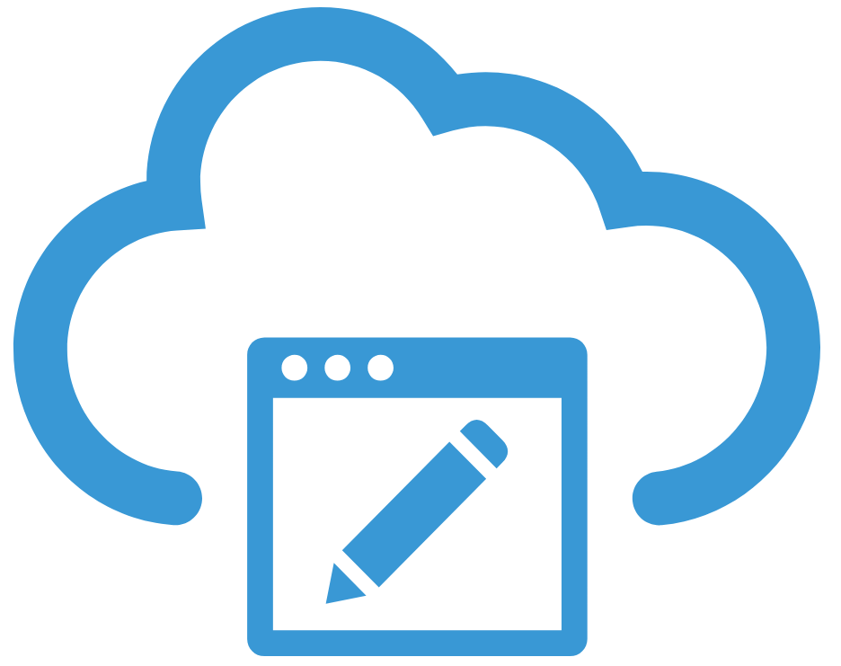
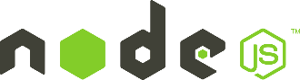

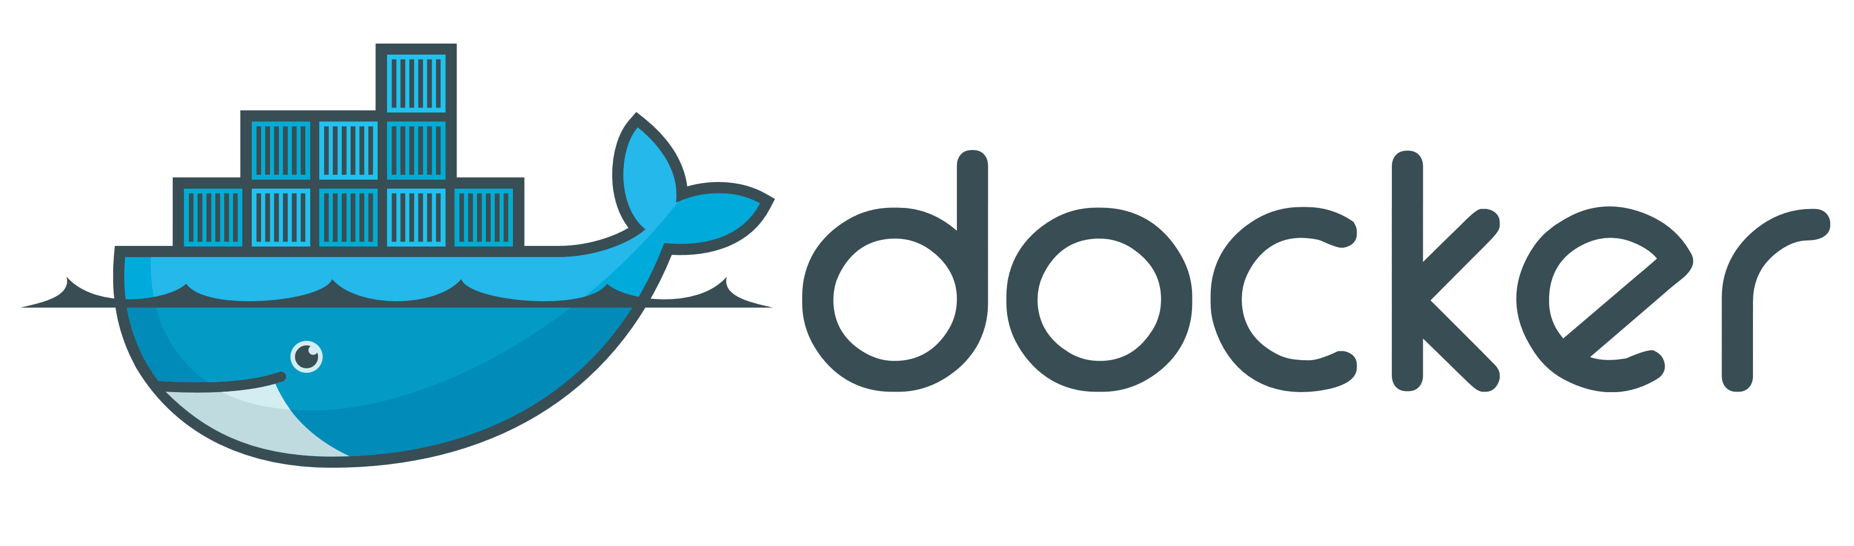
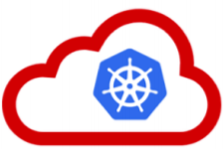



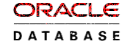

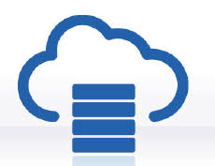
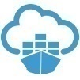

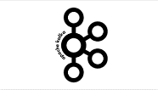

API Portal
Web Shop Portal
µ Customers
µ Orders
µ Products
µ Loyalty
µ Finance
API Platform
Backoffice UI
λ
Event Schema Registry
Event Hub
Notes:
dazzle the audience with a quick dump of all technologies (and cloud services) used for putting the webshop together - for the UI, the API implementation, the datastores and the event bus.

Slide 28

…. Event-(First) Driven
Event Monitor
Product Update
Product added to Shopping Cart
Shop
Products
Event Hub
Topic X
Topic Y
Topic Z
Topic Q
New Customer
Customer Profile Changed
Customer Sign In
Customers
Order Payment Received
Customer Frozen
Customer Loyalty Status Change
Order Create
Order Cancelled
Product Stock Update
Shipping News
Loyalty Program
Order
Logistics
Finance

Slide 29
How? Run & Operate

Slide 30
Run & Operate Microservices
µ
µ
µ
µ
µ
Rapid rollout
Including scale out & recover
Non breaking upgrade & rollback strategies (e.g. canary release)
Agile infrastructure
Relocate, independent of infra specifics
Health management
Monitor and safeguard SLA requirements on response time, success and availability
Scale elastically
TCO management
DevOps: one team creates and runs
Generic Infrastructure Platform for running DevOps Products

Slide 31
The elephant in the room…
whale

Slide 32
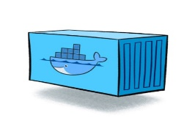
Containers
As vehicle for:
Encapsulate
Build
Share & Ship
Automated Tests
Deploy
Run
Scale
Relocate
Standardize

Slide 33
Looking for a runtime platform for
Compute Node
Notes:
Deploy and Run (Docker Containers)
Distributed infrastructure (scalable and available)
Hide infrastructure from DevOps teams
Auto-healing
Elastic Scale
Wire up the micros – connect dynamically (service discovery)
Load Balance
Provide Persistent storage
Rolling Upgrade
Configuration & Secret Management
Secure

Slide 34
Looking for a runtime platform for
Compute Node
Compute Node
Compute Node
Notes:
Deploy and Run (Docker Containers)
Distributed infrastructure (scalable and available)
Hide infrastructure from DevOps teams
Auto-healing
Elastic Scale
Wire up the micros – connect dynamically (service discovery)
Load Balance
Provide Persistent storage
Rolling Upgrade
Configuration & Secret Management
Secure

Slide 35
Looking for a runtime platform for
Compute Node
Compute Node
Compute Node
Notes:
Deploy and Run (Docker Containers)
Distributed infrastructure (scalable and available)
Hide infrastructure from DevOps teams
Auto-healing
Elastic Scale
Wire up the micros – connect dynamically (service discovery)
Load Balance
Provide Persistent storage
Rolling Upgrade
Configuration & Secret Management
Secure

Slide 36
Looking for a runtime platform for
Compute Node
Compute Node
Compute Node

Slide 37
Looking for a runtime platform for
Compute Node
Compute Node
Compute Node

Slide 38
Looking for a runtime platform for
Compute Node
Compute Node
Compute Node
Cloud Storage
SAN

Slide 39
Looking for a runtime platform for
Configuration Map
Configuration Map
Compute Node
Compute Node
Compute Node
Cloud Storage
SAN

Slide 40

Looking for a runtime platform for
Compute Node
Compute Node
Compute Node

Slide 41
Looking for a runtime platform for
Compute Node
Compute Node
Compute Node
Compute Node
Compute Node

Slide 42
Looking for a runtime platform for
Compute Node
Compute Node
Compute Node

Slide 43
Looking for a runtime platform for
v2
v2
v2
Compute Node
v2
v2
Compute Node
Compute Node

Slide 44
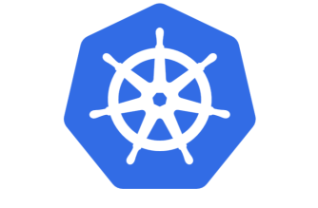

Slide 45
Introducing Kubernetes
Distributed Container Run Time Management platform
Based on Google’s Borg system (in use at Google for over a decade)
Initial announcement: 2014
Kubernetes v1.0 was released on July 21, 2015
A Kubernetes cluster typically spans multiple compute nodes
Either in the cloud, on premises, on a single machine (minikube) or hybrid
K8S manages Pods in which containers are running
K8S schedules Pods on one or more nodes
Docker can be the container runtime; other engines are supported as well, such as rkt and containerd
K8S handles network traffic to, between and from Pods
The kubectl command line interface is used for most management activities

Slide 46
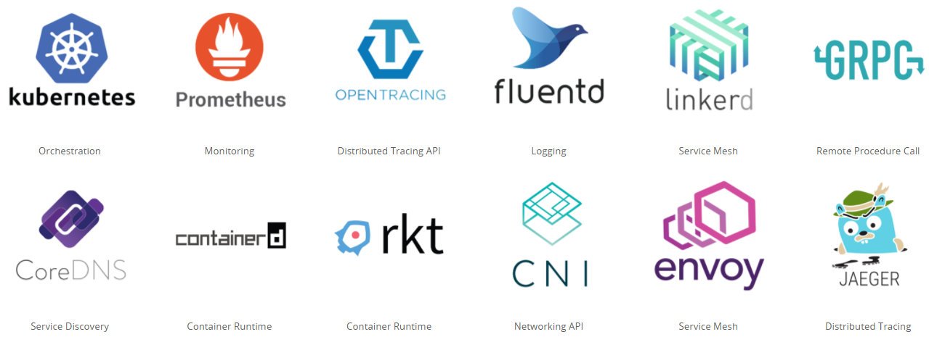
Cloud Native & Vendor Neutral
Cloud Native Computing Foundation - CNCF
Oracle is a platinum member since July 2017
Cloud Native: container packaged, dynamically managed, microservices oriented
Open technology for running container based workloads in a cross cloud vendor neutral way
Notes:
https://www.cncf.io/

Slide 47
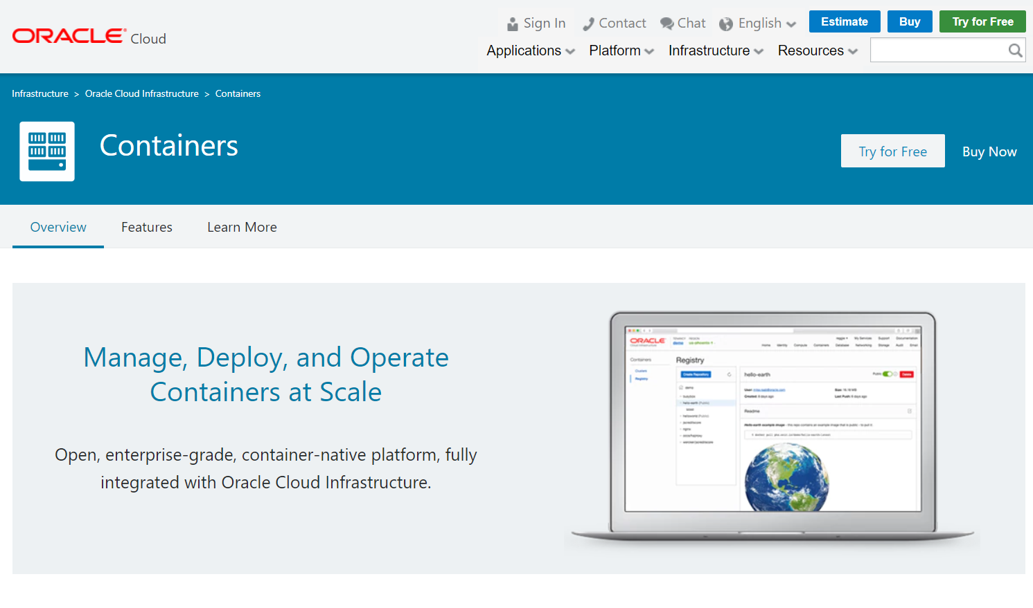

Slide 48
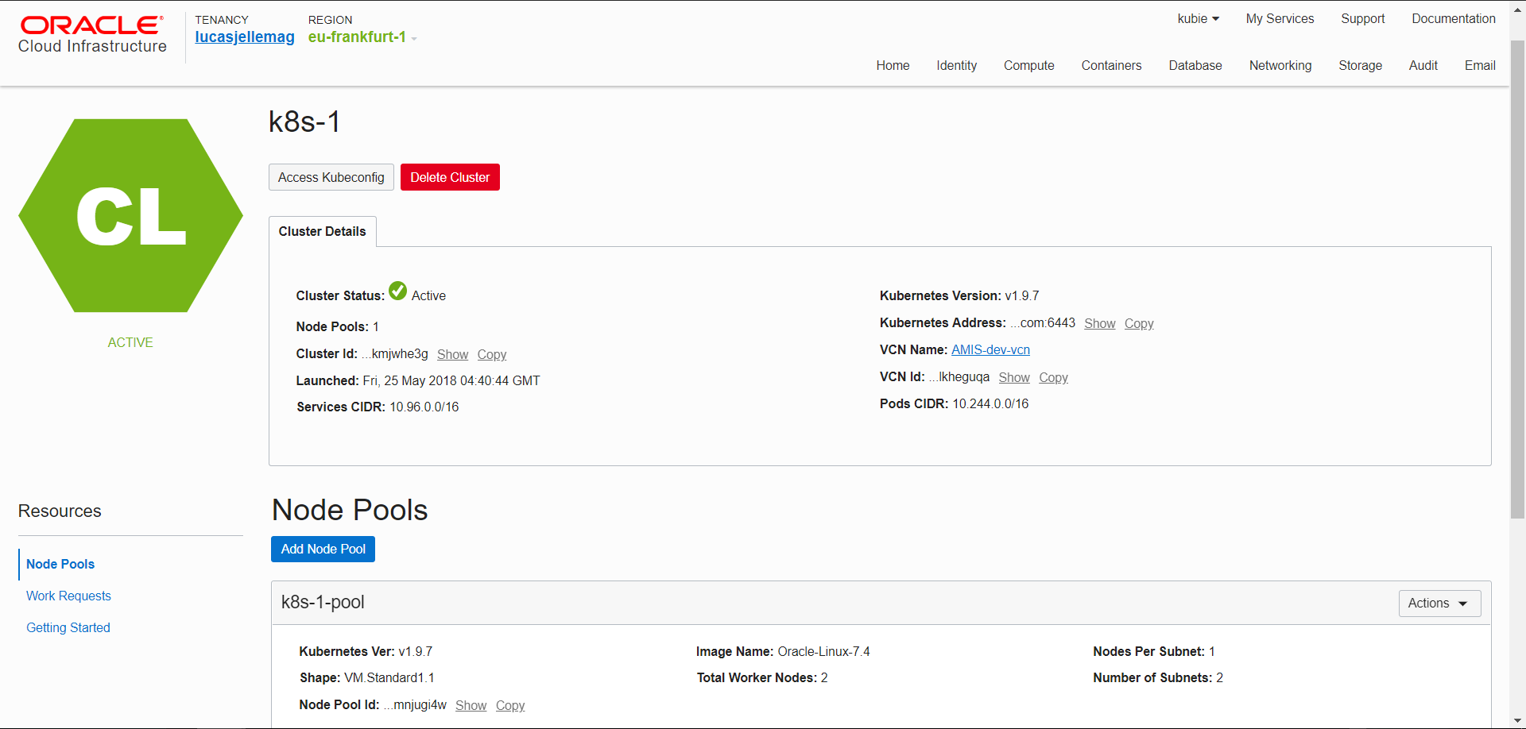

Slide 49
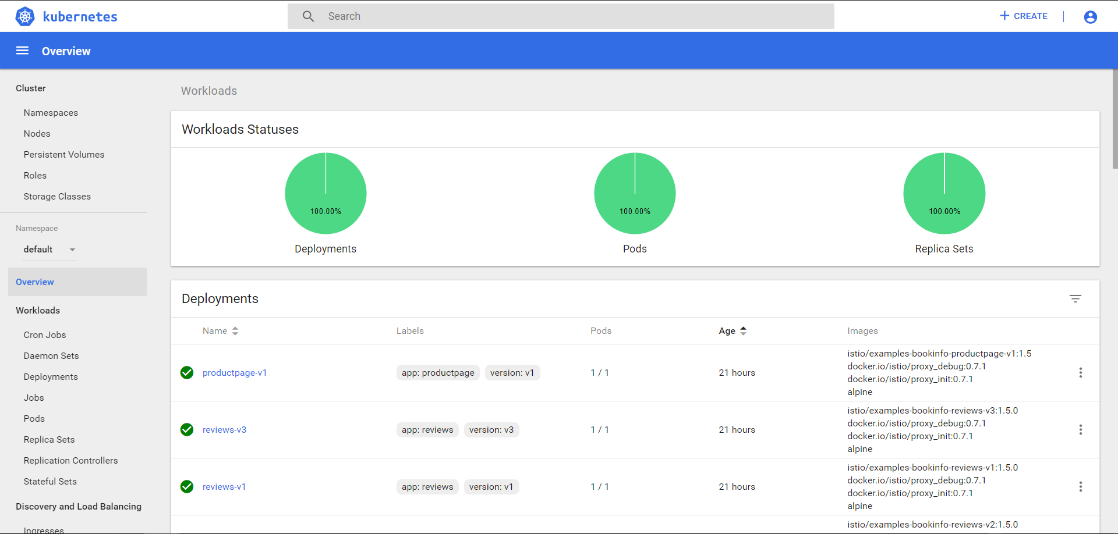

Slide 50
Kubernetes & OKE Demo

Slide 51
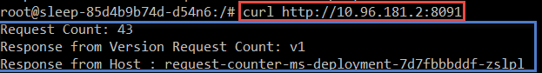
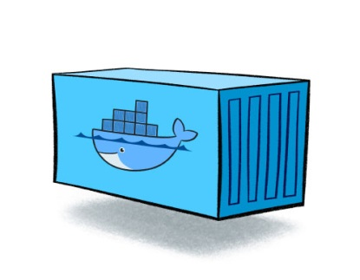
RequestCounter Microservice – V1
/
/health
/ready
/kill
http GET
RequestCounter
counter
Compute Node
Compute Node
Notes:
RequestCounter on K8S
Deployment with two replicas
Readiness Probe, Liveness probe
Kill-switch – special request that can disable liveness
Steps
Apply deployment with kubectl
Show in dashboard /cli two pods are started
Demo calls: load balanced, no shared state
Kill one – continue to make calls (no longer load balanced)
A second pod is started (because of liveness was broken)
Scale deployment to three – show that three pods are running
Upgrade to v2 – using Redis for shared state
Now kill all three (three rapid kill calls); new instances – proceed from same state

Slide 52
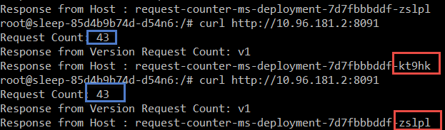
RequestCounter Microservice – V1
/
/health
/ready
/kill
http GET
RequestCounter
counter
counter
Compute Node
Compute Node

Slide 53
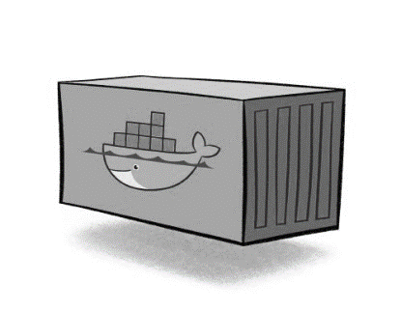
RequestCounter Microservice – V1
/
/health
/ready
/kill
http GET
RequestCounter
counter
counter
counter
counter=0
Compute Node
Compute Node

Slide 54
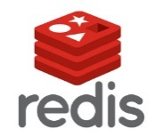
RequestCounter Microservice – V2
/
/health
/ready
/kill
http GET
RequestCounter v2
counter
Compute Node
Cache
Compute Node

Slide 55
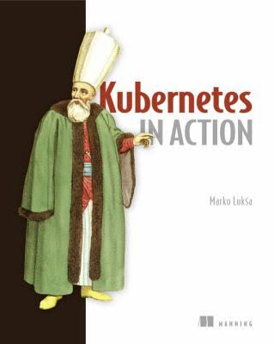

Slide 56
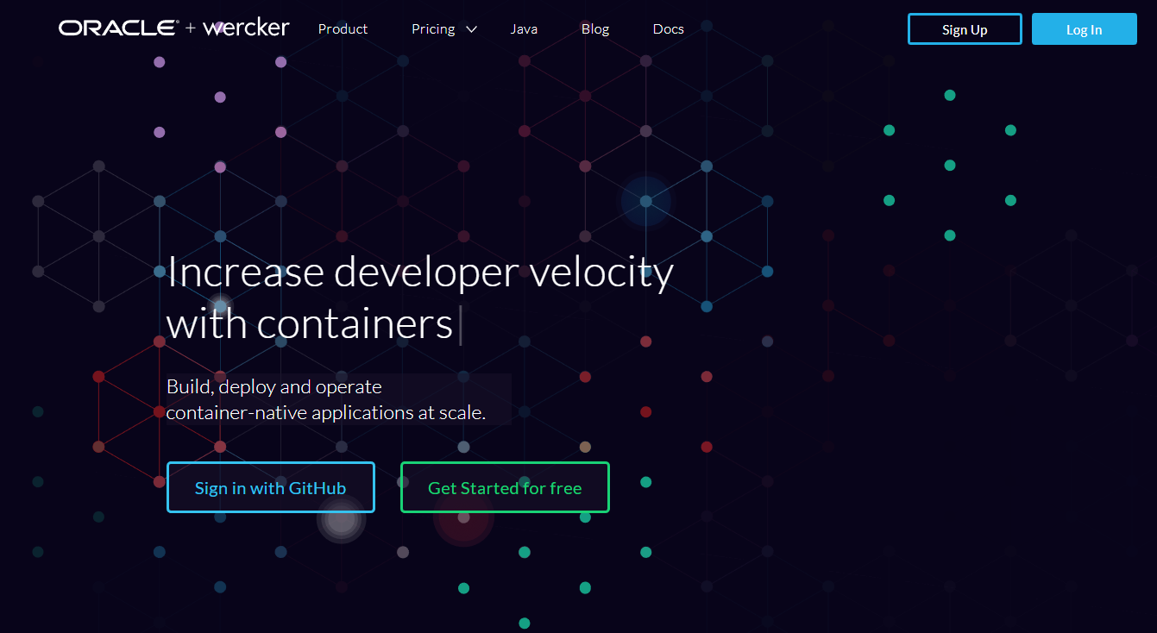
Automated Container [Build | Stock | Deliver] Pipelines
Oracle Wercker

Slide 57
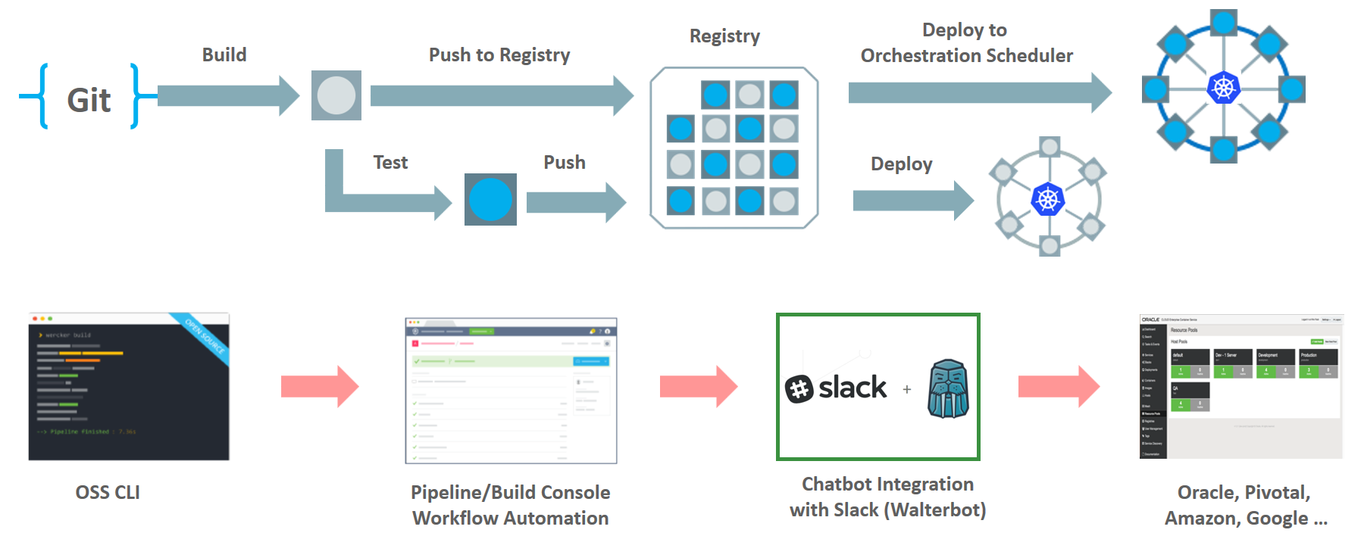
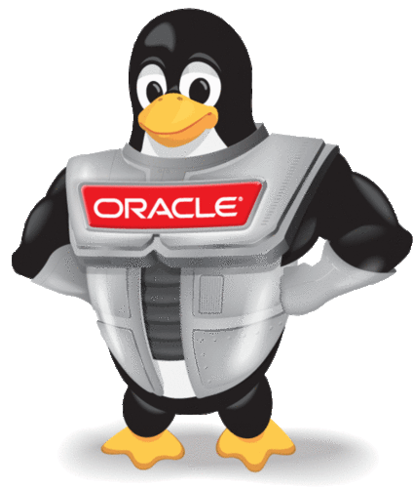
Wercker: Build, Test, Push and Deploy Pipelines for Containers
µ
µ
µ

Slide 58
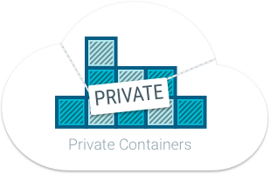
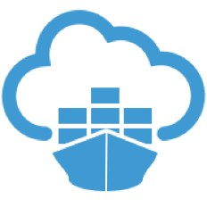
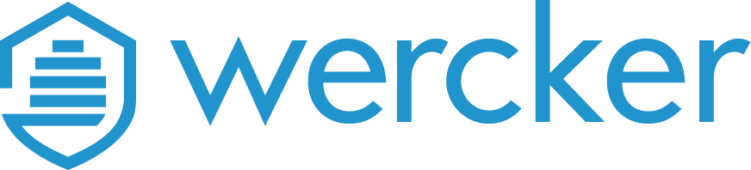
Oracle Container Registry for Your Images
After build and before run – container images need to be stored
Secure (because runtime artefacts)
Accessible (& low latency) to deployment engine and container runtime
Scalable and Smart (no duplicate images and image layers)
Notes:
https://docs.us-phoenix-1.oraclecloud.com/Content/Registry/Concepts/registryoverview.htm?Highlight=registry

Slide 59
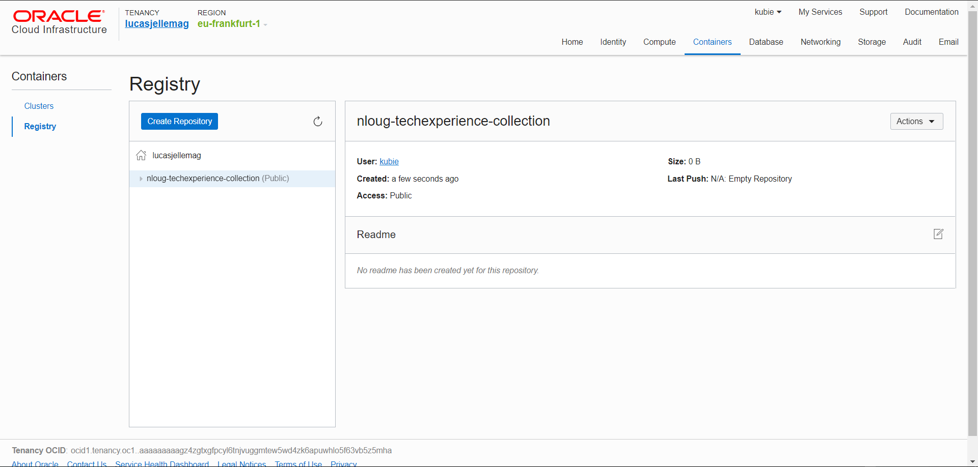

Slide 60
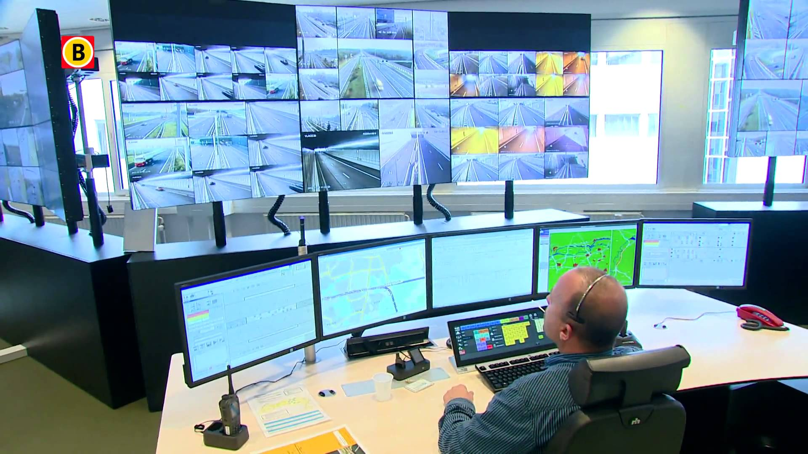

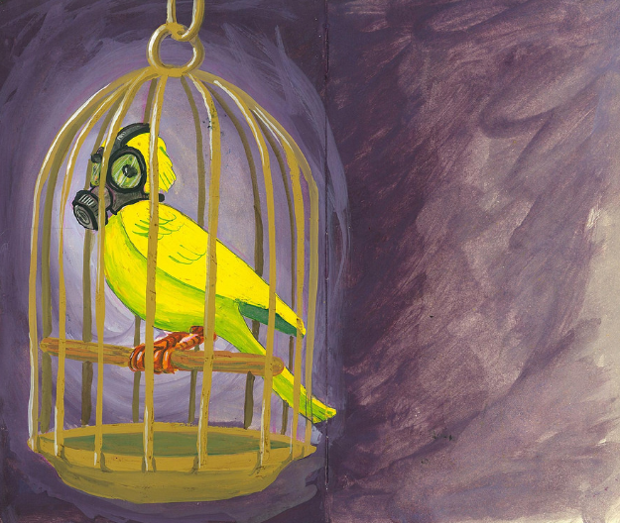
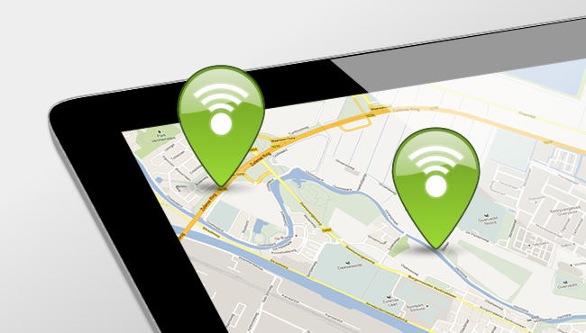
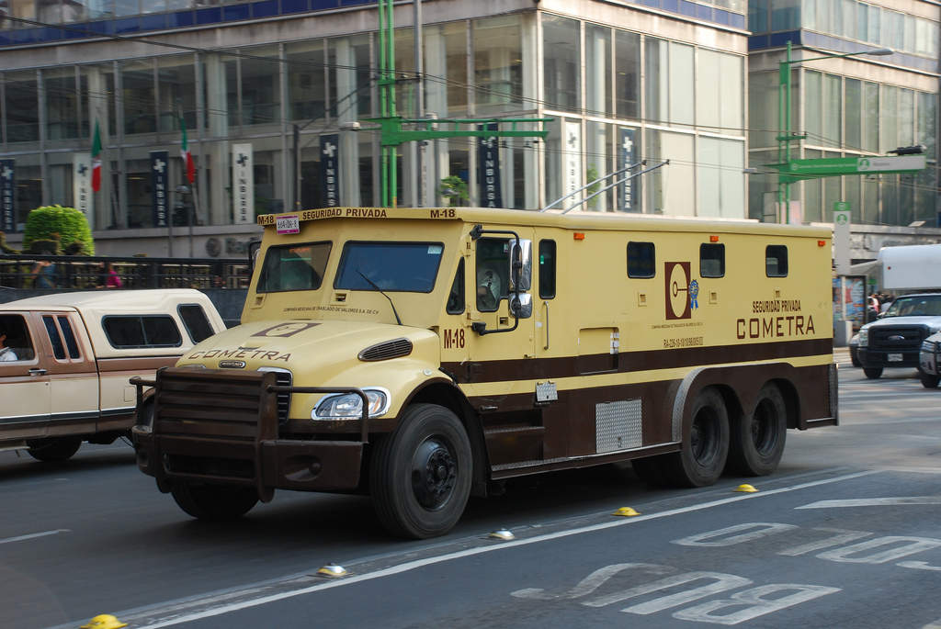



Microservice Runtime Platform - plus
Notes:
Monitor
Health
Load/performance
Tracing
Collect metrics & logs for analysis
Route
A/B, Canary, Authorize/Policy Enforcement, Protocols
Circuit Breaker, Throttle (Rate Limiting)
Mirror traffic for asynchronous testing
Security
TLS
Access control – whitelist/blacklist,

Slide 61


Slide 62





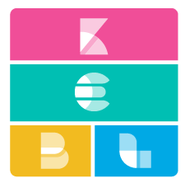


Istio – Service Mesh Operations
Routing
Access Control
Whitelist/Blacklist
Security
TLS
Resilience
Rate Limiting & Circuit Breaker
Monitoring
Trace
Service Graph

Slide 63
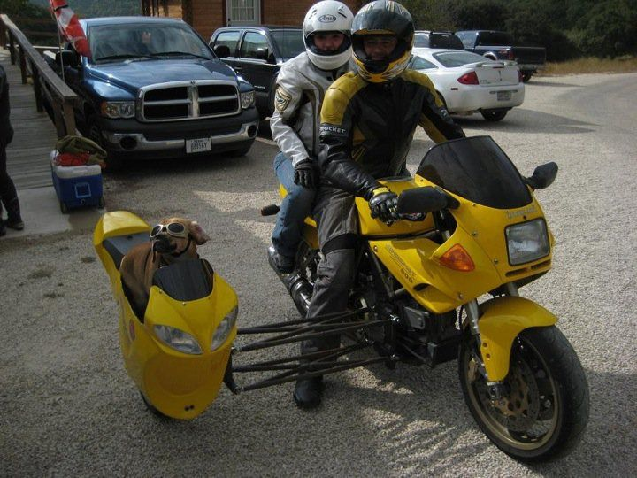
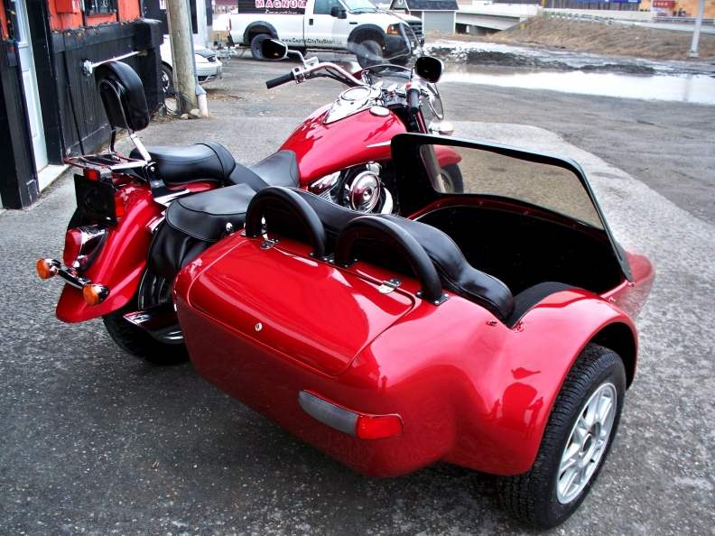

Slide 64
Envoy Sidecar
http(s), tcp,gRPC
Pod
Envoy Sidecar
Metrics, trace, policy checks
Istio Mixer
Configuration
Istio Pilot
TLS Certificates
Istio Auth
Notes:
Docker container
Injected into Pod
Handles all inbound/outbound traffic
Guided by Pilot
Reporting to Mixer

Slide 65
Istio Demo

Slide 66
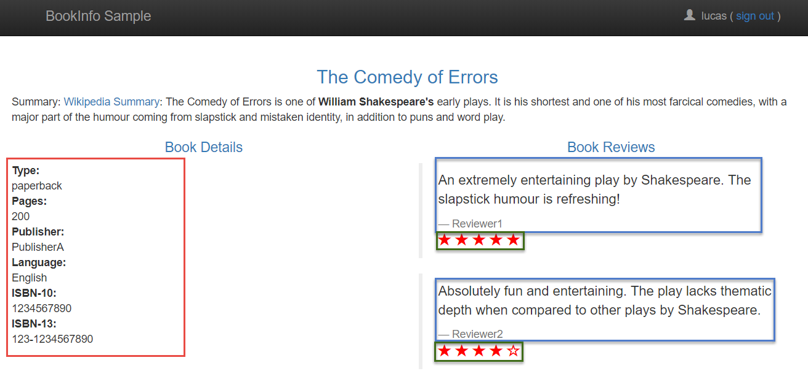
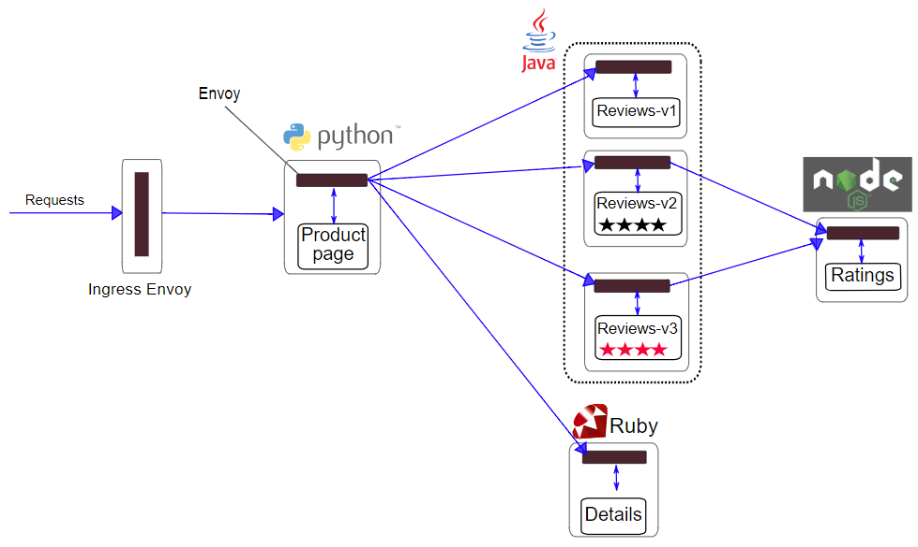

Slide 67

Istio – Bookinfo Demo
10% weight for routing to Reviews-v2
Content based routing to Reviews-v3 for special user
Denier/Blacklist on Details
90%
User = lucas
Notes:
Pod A does sequential calls to B and C
Pod D takes fairly long
Alternative: show bookinfo!

Slide 68
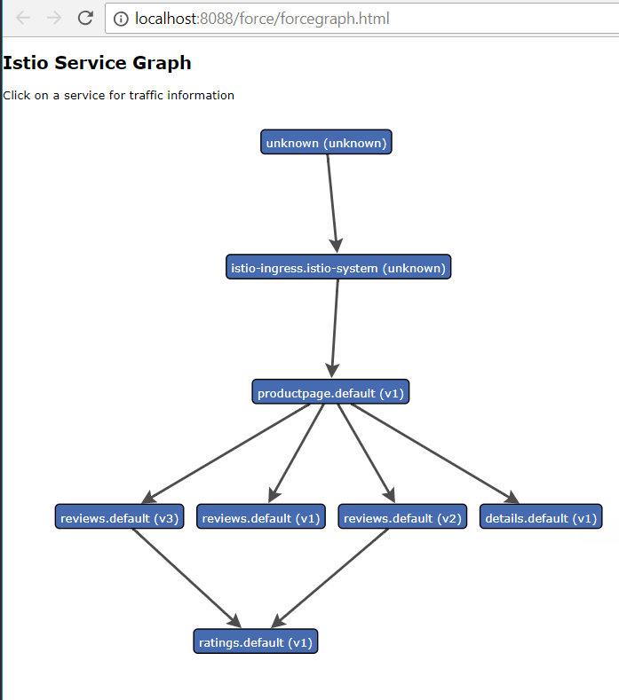
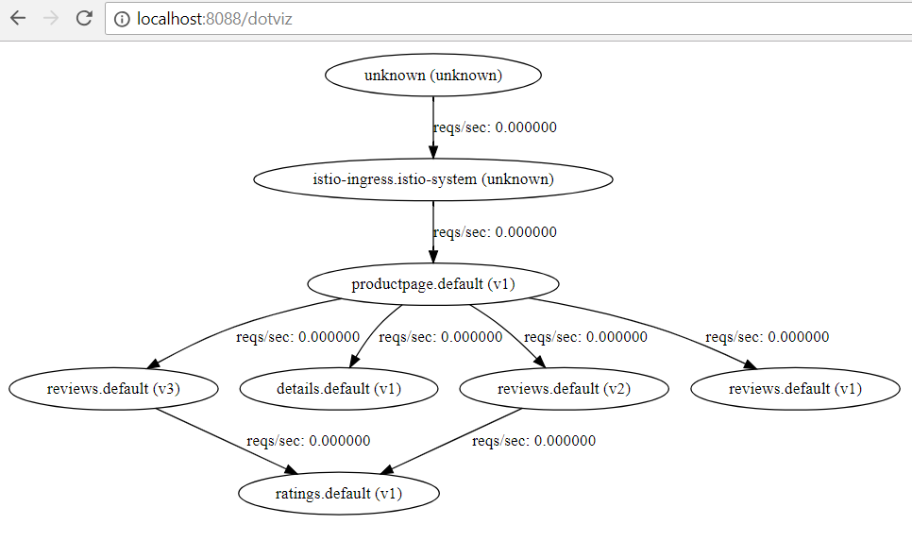

Slide 69
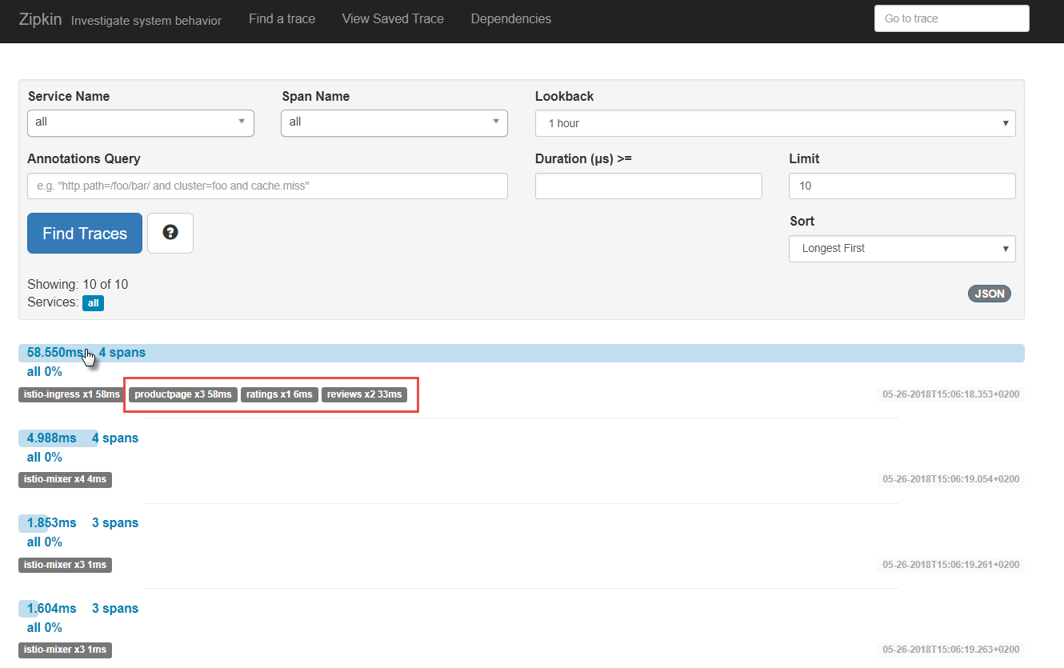
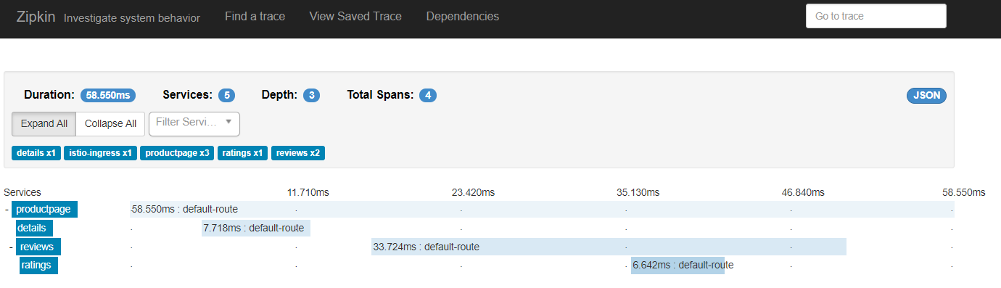

Slide 70
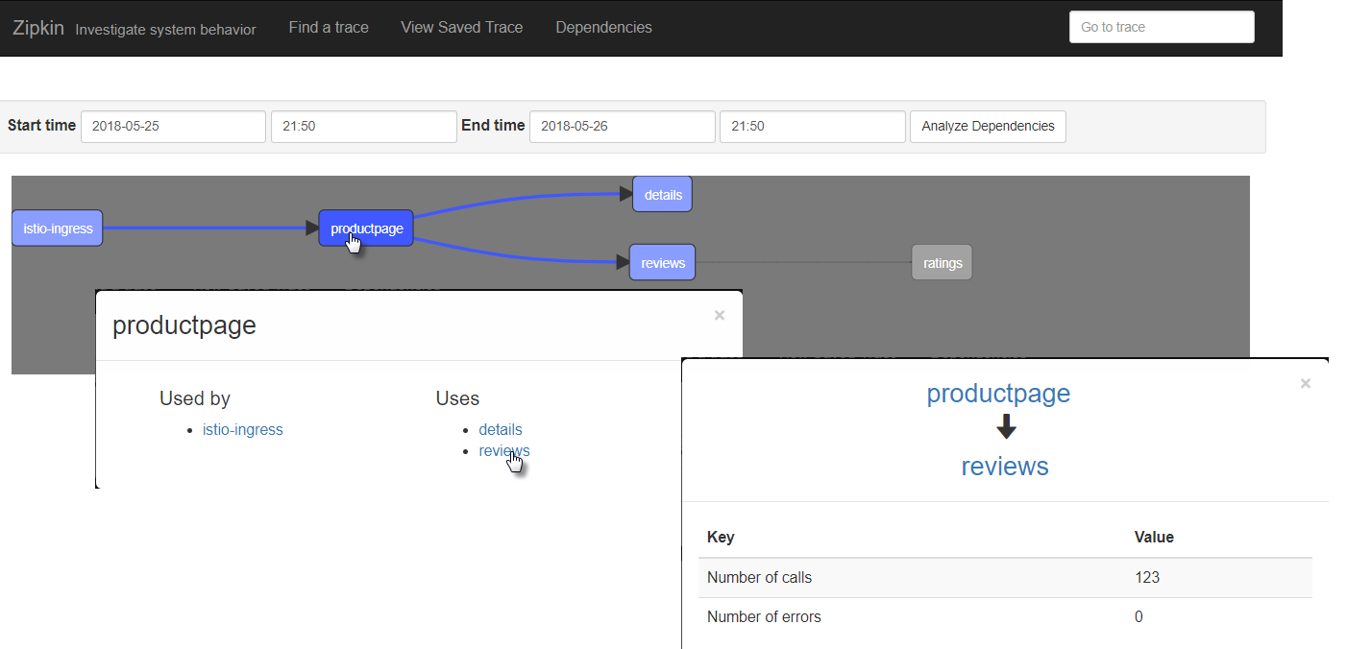
Zipkin Tracing

Slide 71
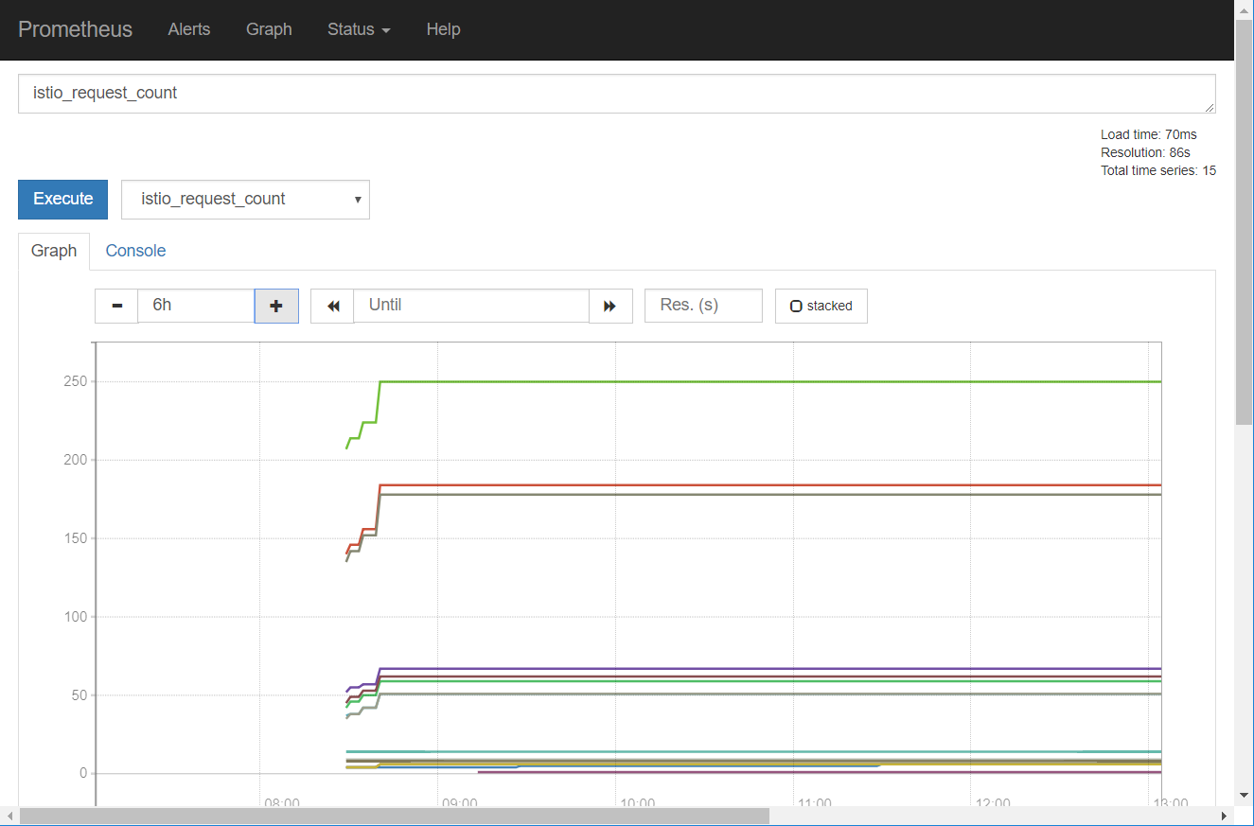
Prometheus

Slide 72
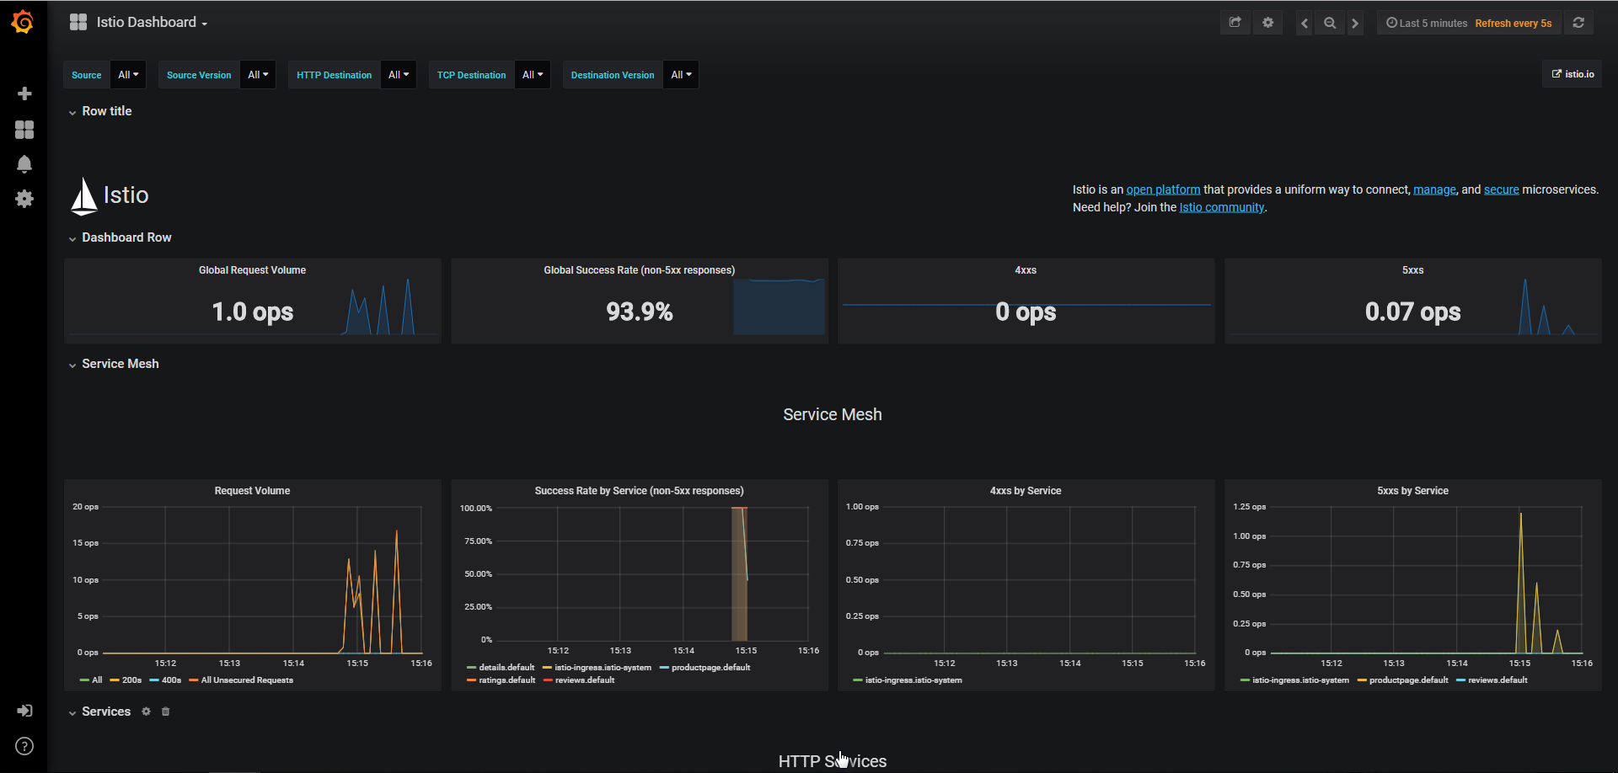
Grafana

Slide 73
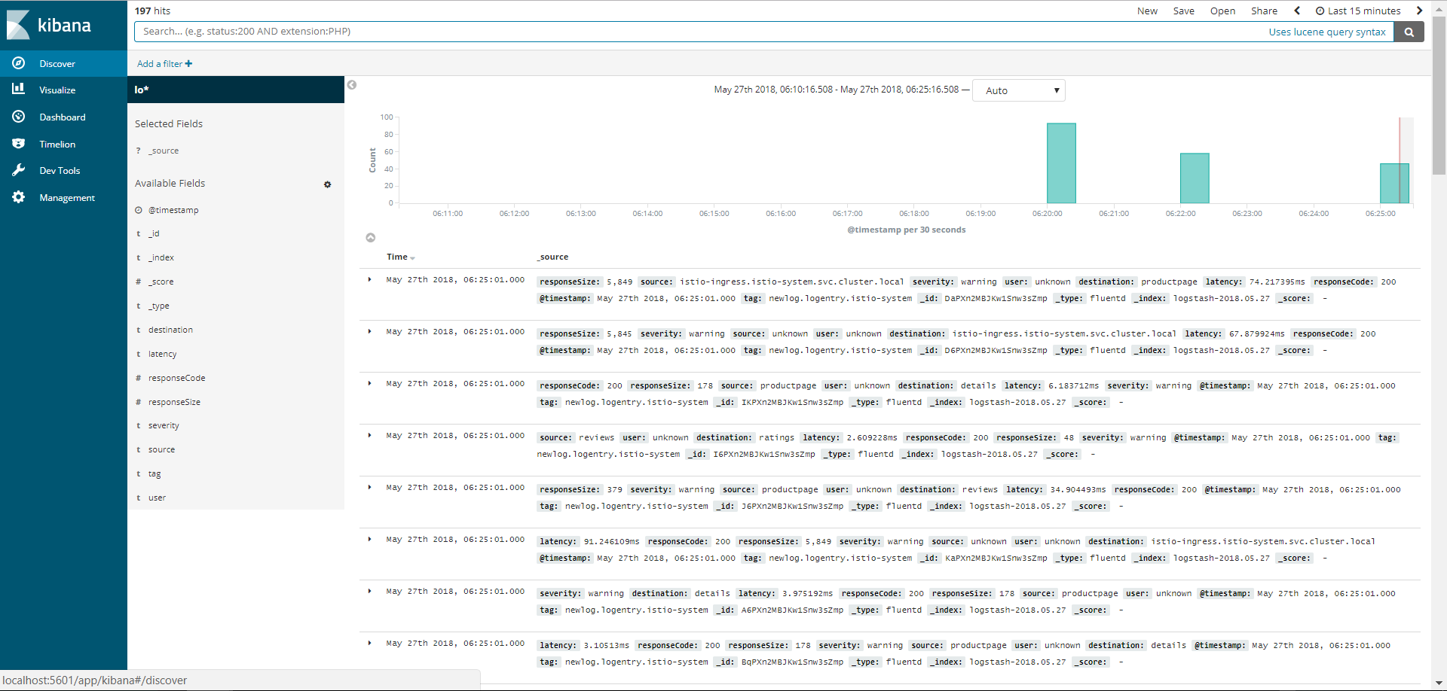
Fluentd + Elastic Stack

Slide 74
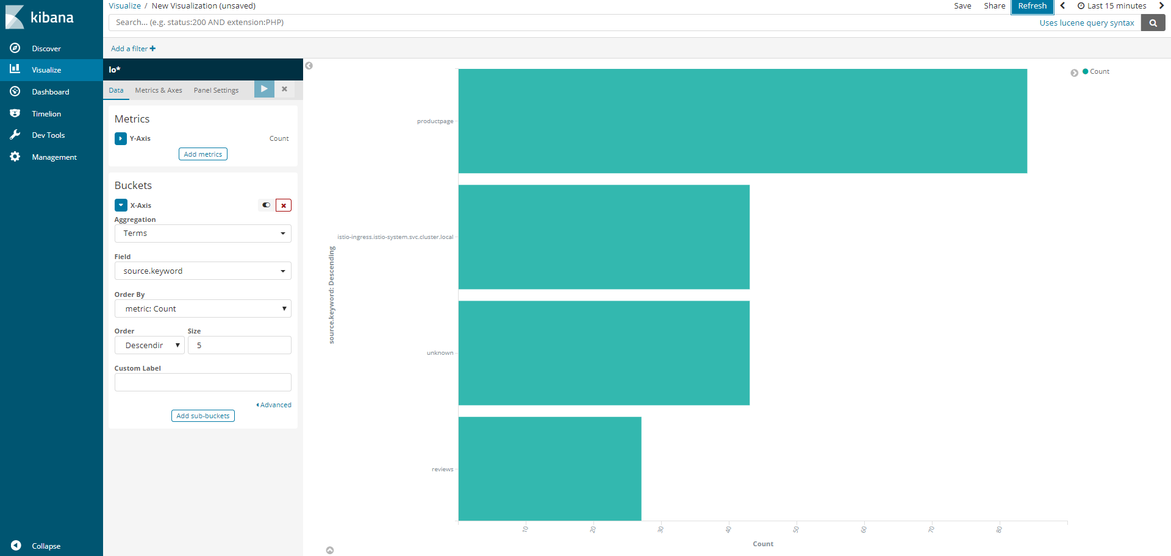
Fluentd + Elastic Stack

Slide 75
Istio – Demo
Each service returns its name and version – and perhaps some payload
And writes some logging
Demo
Call Pod A – only v1 responses
Check Zipkin
Check Grafana
Generate Service Graph
Switch 50% of traffic from Pod A v1 to v2
Header based routing to v3
Check responses
Check Service Graph
Check Kibana
Pod D
v1
Pod A
v3
Pod B
Pod A
v2
http
v2
Pod B
Pod A
v1
v1
Pod C
v2
Pod C
v1
Notes:
Pod A does sequential calls to B and C
Pod D takes fairly long
Alternative: show bookinfo!

Slide 76

Serverless
λ
λ
λ
λ
λ
λ
λ
λ
λ
λ
λ
µ

Slide 77


Open Source Serverless Function Platform
Functions can be implemented in any language
Java, Go, PHP, JavaScript/Node, Python, Ruby
Functions run in their own container
Functions can be accessed via HTTP calls
Routing, load balancing, running is taken care of by Fn Server platform
Platform runs locally, on prem & in cloud
Fn Flow orchestrates workflows across multiple functions
Workflow described in Java
Includes business logic (conditional, parallel execution, exceptions)
µ
Notes:
https://blogs.oracle.com/developers/kubecon-europe-2018-oracle-open-serverless-standards-fn-project-and-kubernetes

Slide 78


Project Fn has announced support for
Notes:
https://cloudevents.io/
https://serverless.com/

Slide 79

Managed Serverless Platform on Oracle Public Cloud
λ
µ

Slide 80












Microservices Platform (Kubernetes & Istio) ++
API Gateway
Cache
Event Hub
Service Broker
Chaos Monkey & Regression Testing
Workflow
Transactions (cross microservice)
RDBMS, NoSQL, Data Lake(Big Data), Fast Data Ingestion
Billing
Notification
Microservices Platform
Storage

Slide 81



Oracle Container Native Microservices Architecture
µ
λ
Foo2
Voice Recognition
API Registry
Event Management
Open Service Broker
Billing Engine
ISTIO
Diagnostics/Monitoring
Prometheus
Developer Cloud
ISTIO
ISTIO
Managed Kubernetes
Block Storage
Cache
RDBMS
LDAP/IdM
NoSQL

Slide 82





Thank you Dank je wel
Blog: technology.amis.nl
Email: lucas.jellema@amis.nl
: @lucasjellema
: lucas-jellema
: www.amis.nl, info@amis.nl

Slide 83
Technologies
Docker containers
CD Pipelines (Wercker, Developer CS, Jenkins X)
Kubernetes as deployment platform
Distributed
Rolling Upgrades
Load Balancing & Networking
Failover
Elastic scaling
Helm for predefined rollout
Istio plus side cars
Service Mesh
Routing – policies, authorize, A/B, canary, throttle
Metrics
Circuitbreaker
Prometheus – collect metrics

Slide 84
Technologies (2)
Grafana – Visualize metrics
Vizceral – visualize traffic
Kafka – events
Elastic – logs??
Redis – cache??
API Gateway??
Camunda/Conductor – workflow
Fn - Serverless

